Slide 1
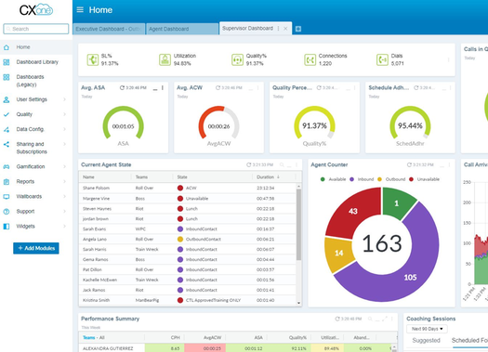
CXone Performance Management
Inspire employees to improve performance and align with your customer experience goals

Slide 2
Role-Based Dashboards
Agent to executive performance dashboards
Data Aggregation Platform
Consolidate data from CRM and other systems
What is CXone Performance Management?
Custom Wallboards
Performance visibility
in the click of a button
Real-Time Reporting
As well as historical and transaction-level data
Automated Gamification
Robust Rewards & Recognition
Surveys & Coaching
Tailor training based on individual needs

Slide 3
What benefits can you expect?
Decrease Employee Attrition
Increase Employee Engagement
Create a single source of truth for your data
Increase Operational Efficiency
Reduce Supervisor Workload
Maximize Training ROI

Slide 4
CXone Performance Management Customer Proof:
Challenge: Limited performance visibility & manual reporting processes
Results: 40% increase in Net Revenue Per Call, 80% increase in Net Promoter Score (NPS)
CUSTOMER
Challenge: Manual data aggregation & low productivity
Results: 68% reduction in ACW & 40% reduction in AHT
CUSTOMER
Challenge: High attrition rates & low employee engagement
Results: 26% increase in utilization, 19% reduction in attrition, 35% reduction in annual training hours
CUSTOMER

Slide 5
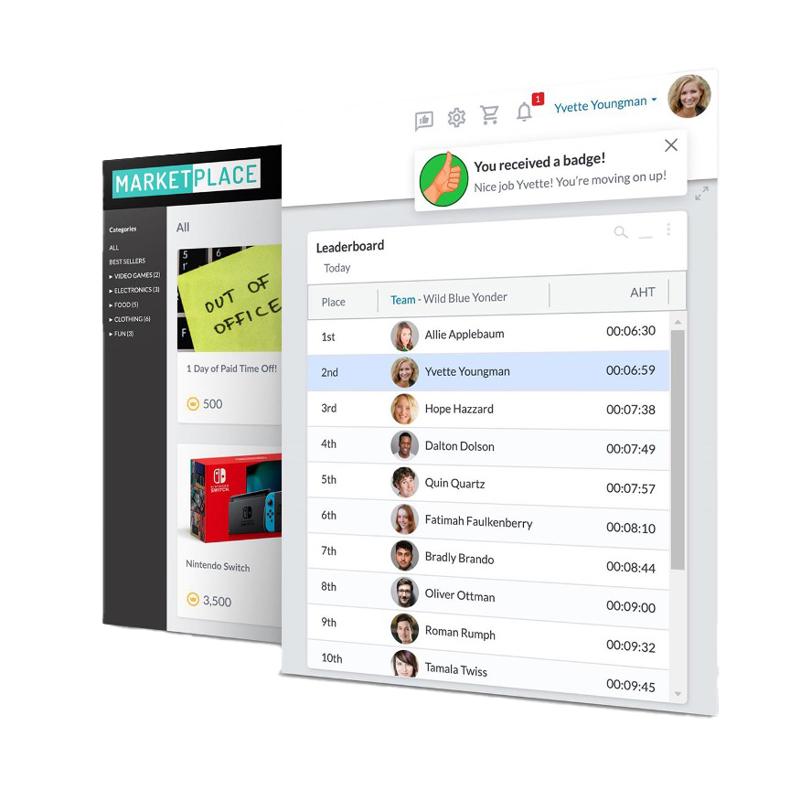
What’s the ROI?
CXone Performance Management typically saves organizations
3-5 times what it costs them.

Slide 6
ROI Example:
IF
100 Agents
Paid at $15.00 an hour
A 75% Productivity Rate
A 30% Attrition Rate
Adding CXone Performance Management helps increase productivity rate to 80% (a very common improvement), and drop attrition rate to 25% (also a very common improvement) you would see:
AND
9,450 more productive hours annually
About $9,375 in savings on annual attrition
And a net ROI of about $99,000 annually which includes the purchase of the product
THEN

Slide 7
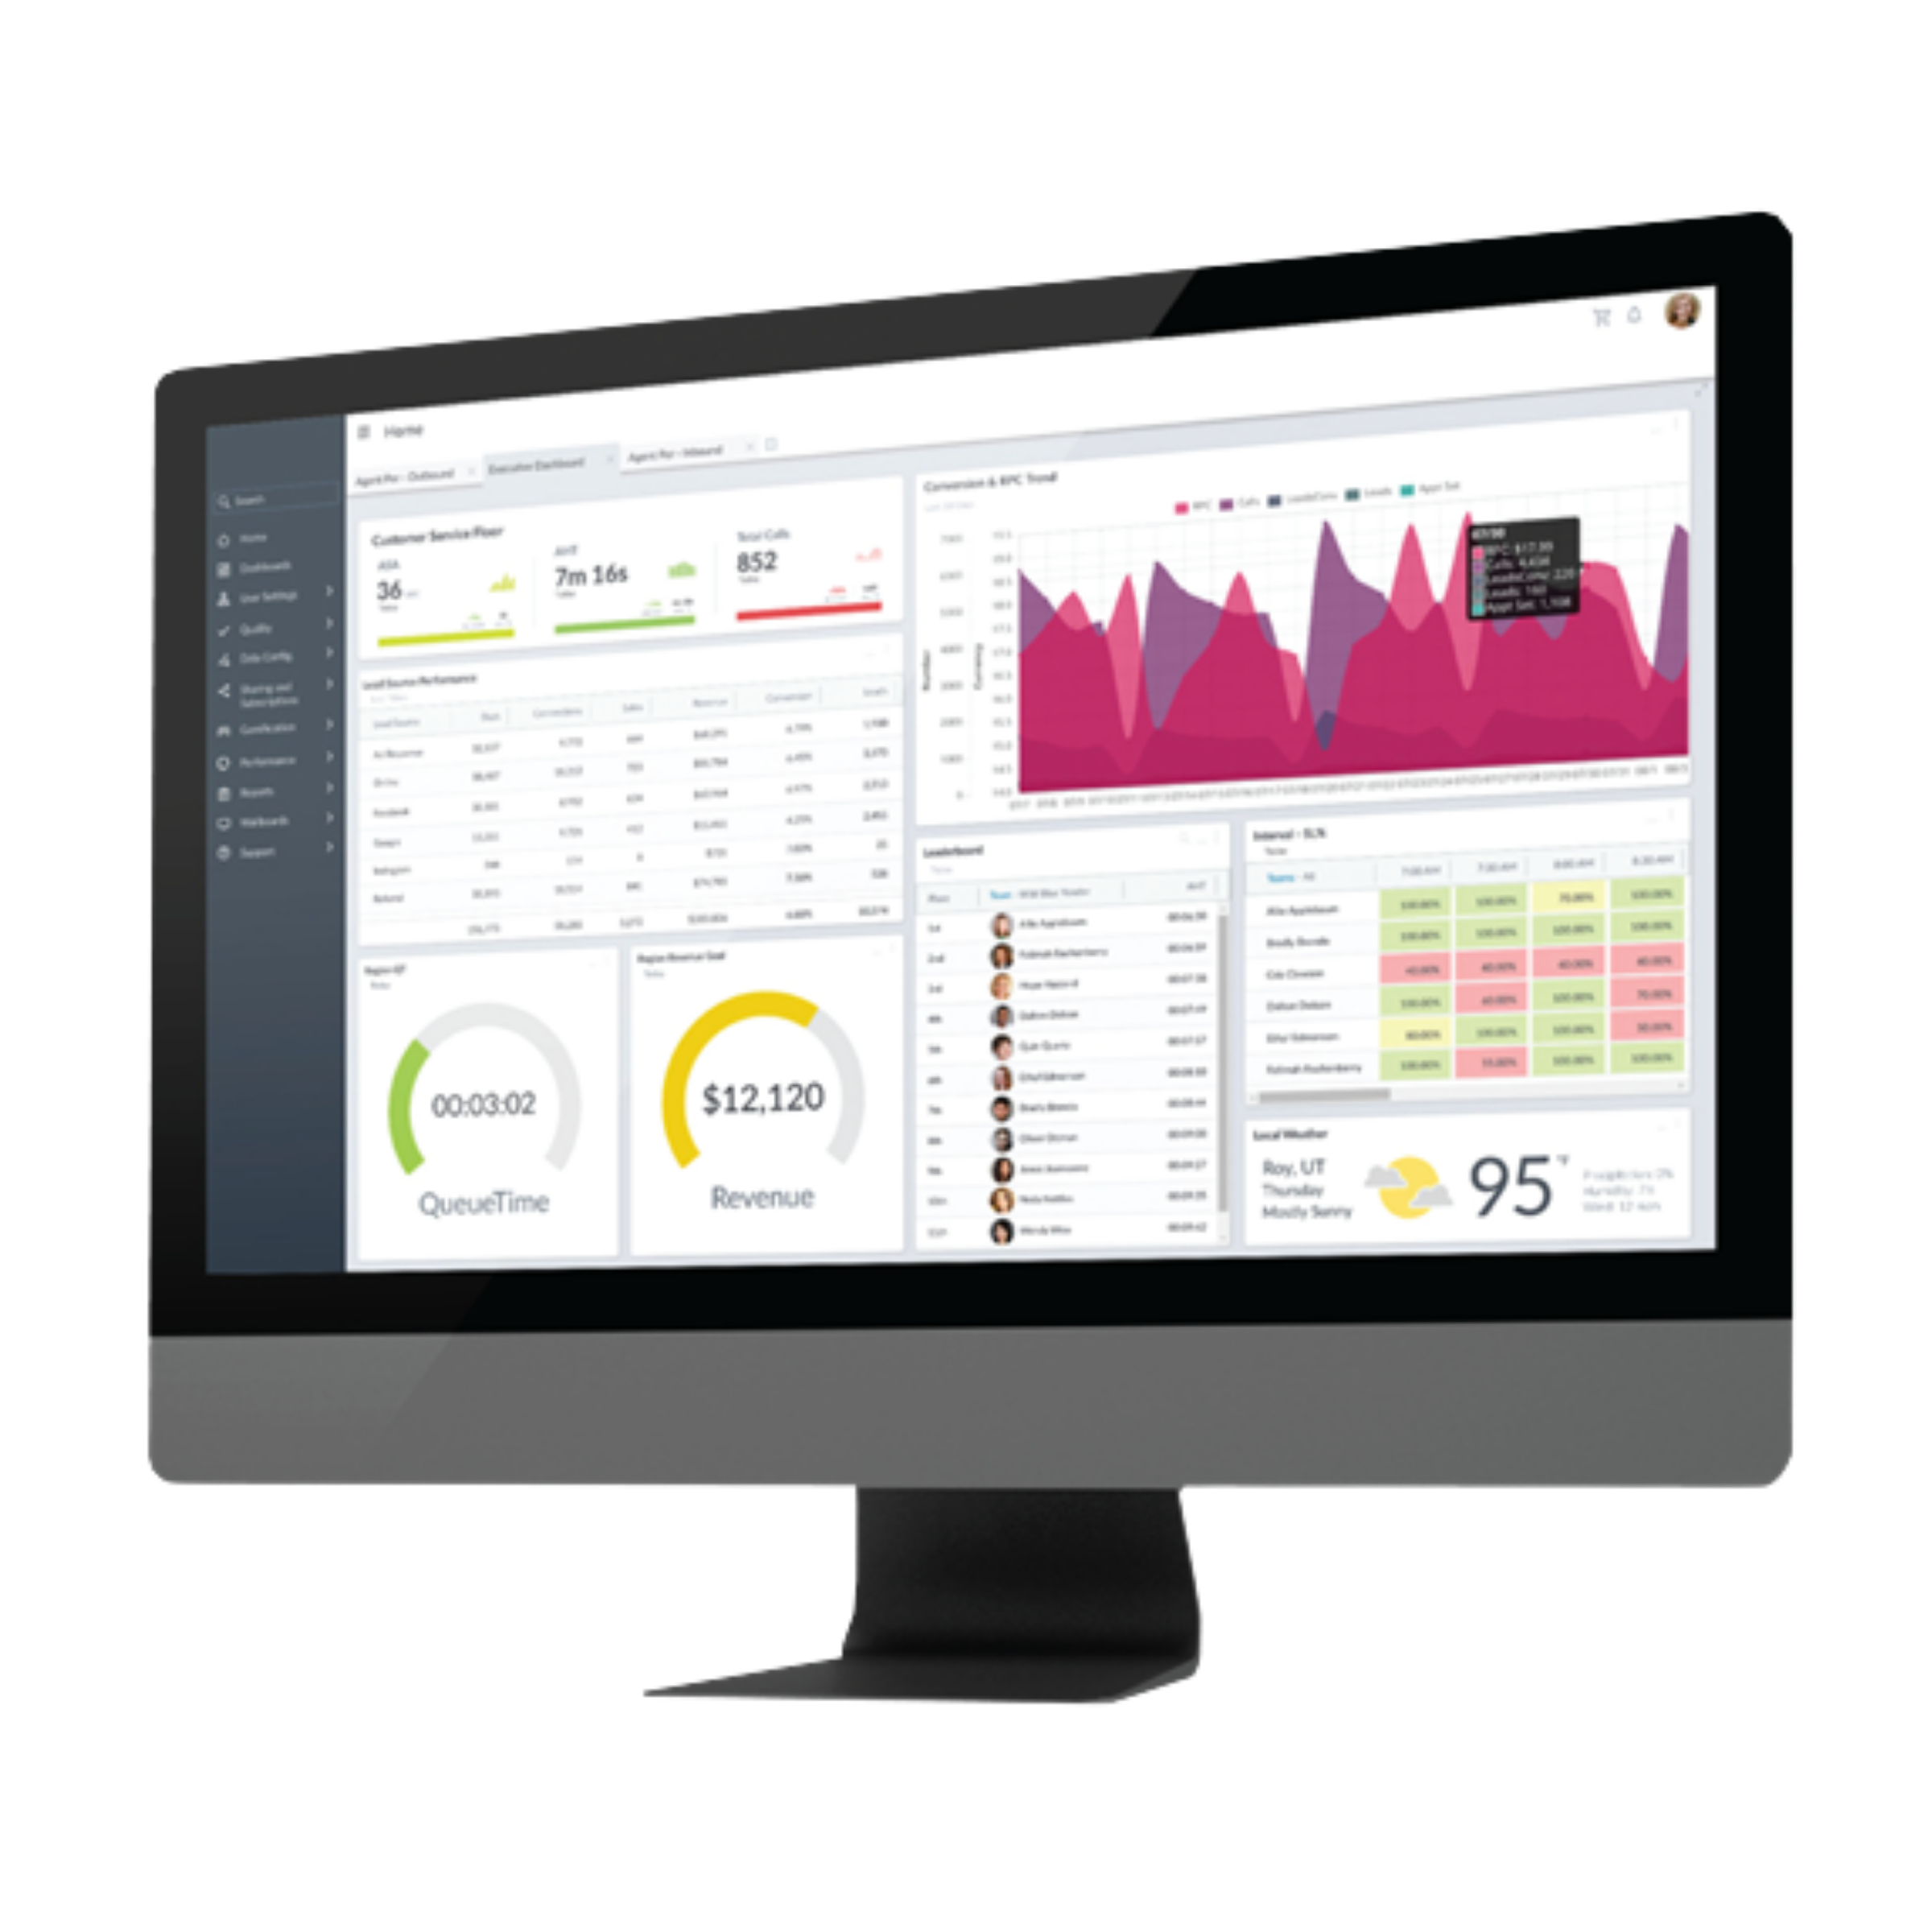
CXone Performance Management
Aggregated Data
Real-Time Reporting
Enterprise Visibility
Decreased Supervisor Workload
Engaged Workforce

